Slide 1


Slide 2

½ cent Dedicated Streets Tax
November 2019
10-Year Sunset
Estimated to generate $1,300,000 annually
Effective January 1, 2020
What does this mean for shoppers?
  Spend $2 - $0.01 for streets
  Spend $10 – $0.05 for streets
  Spend $100 - $0.50 for streets
47% of sales tax is paid by nonresidents

Slide 3
½ cent Dedicated Streets Tax
100% of the ½¢ dedicated streets tax will be placed in the Streets Trust Fund to be used only on those items in Resolution 13-2019.
The City will also transfer $500,000 annually from the General Fund to the Streets Trust Fund for those identified projects.

Slide 4
Citizen Input Through the Comprehensive Plan
44% Bad or Very Bad
24%

Slide 5
Citizen Input Through the Comprehensive Plan

Slide 6
Historical Street Funding
*165,000 funded through a grant

Slide 7
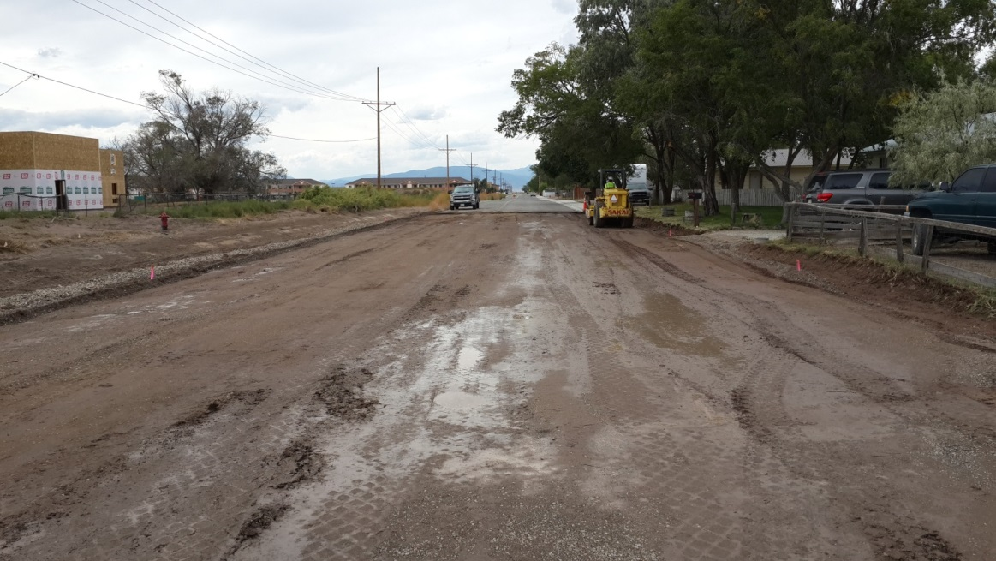
Street Facts
63.45 total miles of roads
  58.79 miles of paved roads
  4.66 miles of unpaved roads
  72.8 miles to Walsenburg
It costs roughly $300,000 per block to build/rebuild a new road or $500 per linear foot.
  A new road should last 15-20 years before significant maintenance is needed.
Estimated that 1/3 of our streets need to be rebuilt!

Slide 8
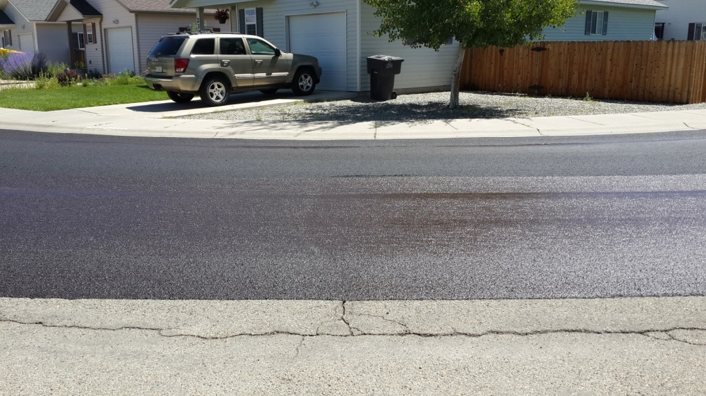
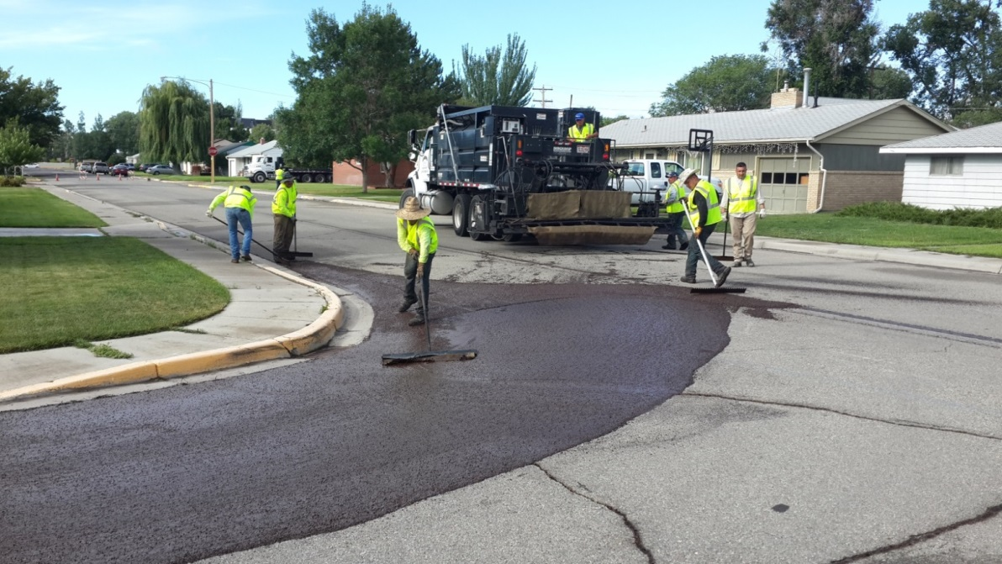
Street Facts
It costs roughly $69,120 per block to overlay a road or $2.31per square foot. Extends the life of the street by 10-15 years and can only be performed on streets in adequate condition.
It costs roughly $27,300 per block to slurry seal a road or $0.91 per square foot. Will extend the life of the street by roughly 5 years, but can only be done on streets in adequate condition.

Slide 9
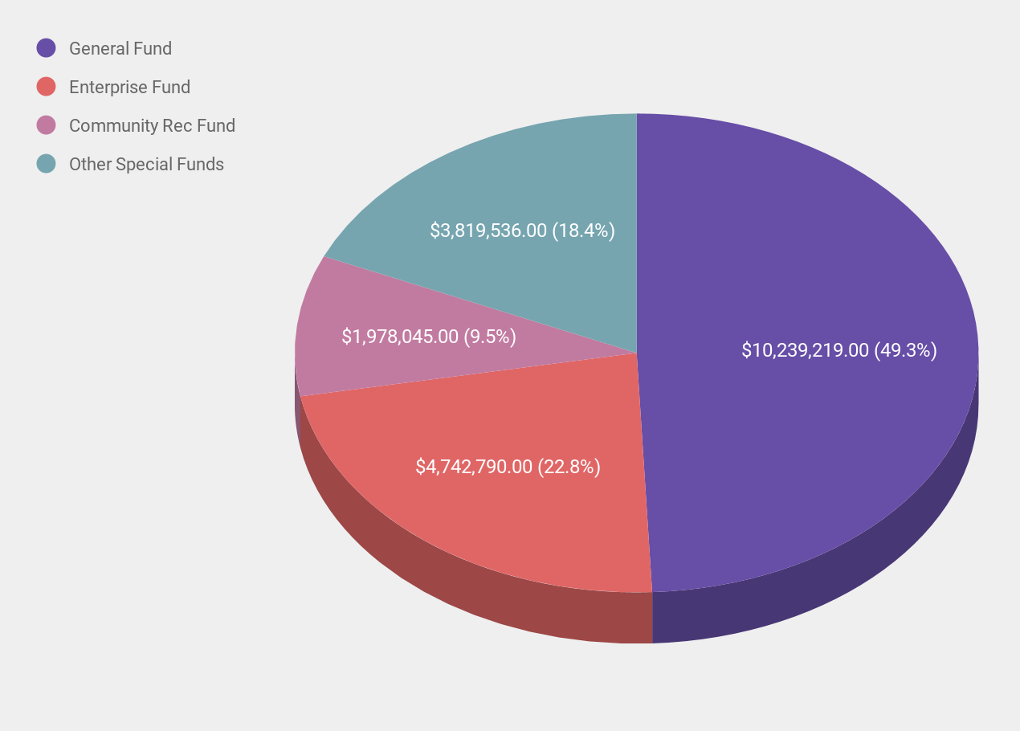
2019 Budget Revenues

Slide 10
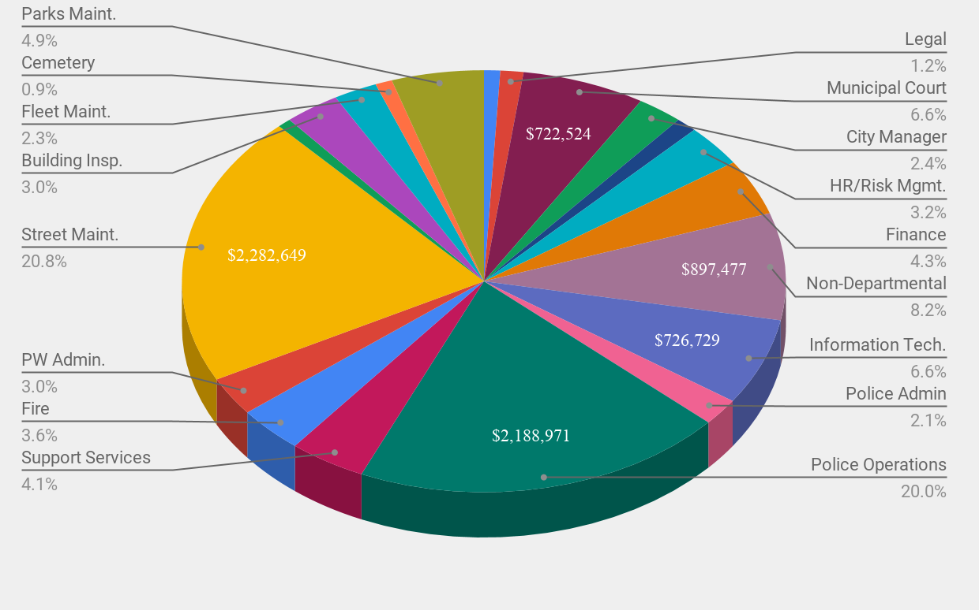
2019 General Fund Expenditures
operations & capital (streets & equip.)

Slide 11
Regular Growth in Sales Tax Cannot Solve
Sales Tax Collection 2014-2018
  2014 – 3.05% increase = $167,439
  2015 – 4.82% increase = $240,067
  2016 – 4.78% increase = $266,941
  2017 – 2.51% increase = $150,659
  2018 – 4.63% increase = $283,268
Comparative Increases in Operations
  Annual increase for general fund health insurance at 4% is approximately $28,000.
  A 3% increase in other operations such as gas, oil, materials, etc. is approximately $89,500.
HUTF brings in about $260,000 per year and has grown only 4% since 2014
Since 2015 the City has received $6,703,054 in grants
1 block = $300,000

Slide 12
Cutting Services Cannot Solve
Average cost of construction for just one block is $300,000
What is expendable out of the General Fund?
  Legal Division - $138,320
  Municipal Court - $722,121
  City Manager Office - $292,052
  Finance Department - $446,440
  City Council - $94,847
  Parks Department - $539,080
  Economic Development - $135,680
  Art Program - $25,000
  Cut Personnel – General Fund Personnel Costs (minus public safety & streets) = $2,707,023
    Therefore, to get $1,300,000 we would need to cut 48% of employees.

Slide 13
Citizen Streets Committee
Purpose: Through community volunteers representing all areas of Alamosa, prioritize street projects for City Council consideration.
Structure:
  Two volunteers from each ward
  Two at-large volunteers
  Two business owners/major employers/ACEDC/Chamber
Process:
  Identified 80 streets needing repair for a total of 21.76 miles
  Prioritized 16 streets for next 10 years for a total of 7.5 miles – 12% of streets
  Also recommended $400,000 each year for sidewalk & maintenance programs (increase from existing $220,000)
  Council adopted a majority of the recommendation with mostly changes to timing.

Slide 14

Resolution 13-2019
Approved unanimously by City Council on July 17, 2019
  Annual sidewalk & overlay/maintenance programs not to exceed $400,000
Streets 2020 - 2023
  State Avenue small overlay (Cascade Avenue to State Avenue Bridge)
  Fourteenth Street overlay (Alamosa Avenue to Ross Avenue and Hunt Avenue to County Rd 110 South)
  First Street in 3 phases (Monterey Avenue to State Avenue)
  Twelfth Street overlay (Ross Avenue to County Rd 110 South)
  State Avenue in 2 phases (Sixth Street to Thirteenth Street)
Streets 2020 – 2023 – No Dedicated Sales Tax
  First Street

Slide 15
Resolution 13-2019
Streets 2024 – 2027
  Victoria Street (HWY 160 to Thomas Avenue)
  Washington Avenue (Tremont to W. Eighth Street)
  Pike Avenue (First Street to HWY 160)
  La Veta Avenue (Main Street to Sixth Street)
  Second Street in 2 phases (San Juan Avenue to West Avenue)
  West Sixth Street (Washington Avenue to Tremont Street)
  Seventh Street (HWY 285 east to its terminus east of Alamosa Avenue)
Streets 2024 – 2027 – No Dedicated Sales Tax
  First Street
  State Avenue

Slide 16
Resolution 13-2019
Streets 2028 - 2030
  Poncha Avenue (HWY 160 to Third Street)
  West Seventh Street (Washington Avenue to Tremont Street)
  Tremont (W. Seventh Street to Washington Avenue)
  Maroon Drive overlay (Carroll Street to W. Lakewood Drive)
  Graf Drive (Clark Street to Carroll Street)
  Alamosa Avenue (Seventh Street to Eighth Street)
Streets 2028 – 2030 – No Dedicated Sales Tax
  State Avenue

Slide 17
Resolution 13-2019
Streets if funds remain
  Third Avenue (State Avenue to Richardson Avenue)
  Thomas Avenue (Murphy Drive to Clark Street)
  Del Sol (HWY 160 to Clark Street)
  State Avenue (Thirteenth Street to Airport Road)
  Ross Avenue (Fourteenth Street to Seventeenth Street)
  Sidewalk and overlay programs if funds are less than $400,000

Slide 18
Future Spending on Streets

Slide 19
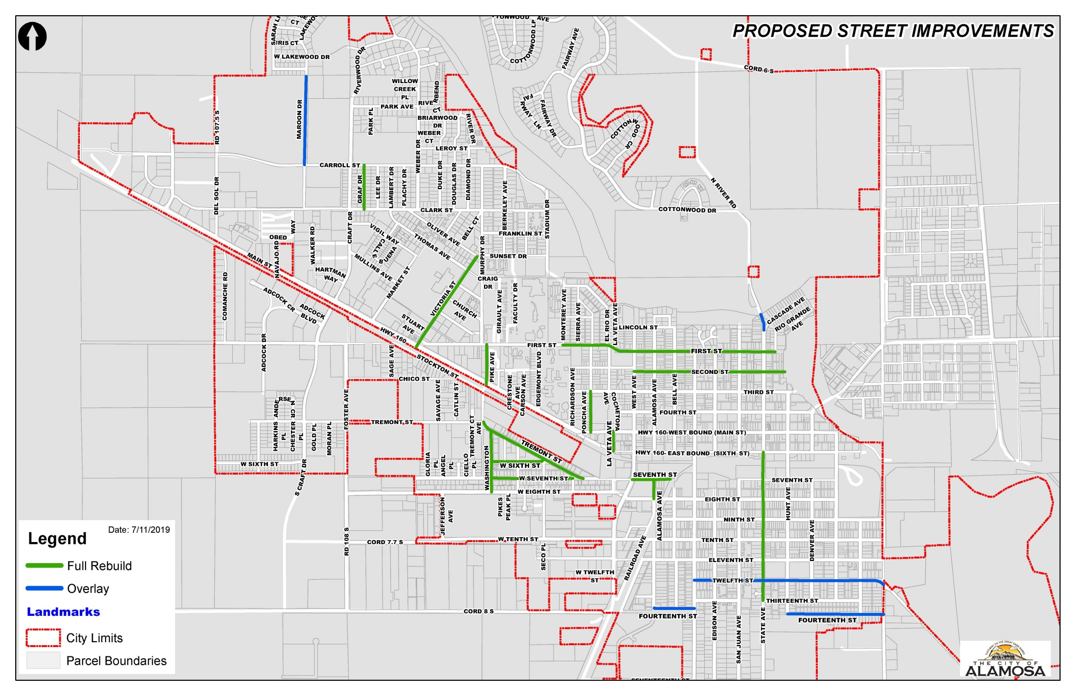

Slide 20
Meeting Promises
Total City Sales Tax is 3.2%
General sales tax is 2.2%
Parks & Recreation Dedicated Sales Tax is ½%
  Passed in 1988 and does not sunset
  Construction of the Family Recreation Center and equipment, Rodeo Ground enhancements, lighted tennis courts, and expanded the golf course to 18-holes
  Recreational programming
Water/Wastewater Bond Financing Dedicated Sales Tax is ½%
  Passed in 1992 and extended in 2005 with a sunsets in 2034
  Used to build waste water treatment and water treatment facilities

Slide 21
Sales Tax Rates
City Total
Alamosa 3.2% 7.9%
Alamosa w/ streets 3.7% 8.4%
Center 2% 7.5%
Cortez 4% 7.35%
Del Norte 2% 7.5%
Durango 3.5% 8.4%
Gunnison 4% 7.9%
La Junta 3% 7.9%
Monte Vista 2% 7.5%
Monte Vista w/ 1¢ 3% 8.5%
Pueblo 3.7% 7.6%
Salida 3% 8.65%
South Fork 2% 7.5%
Trinidad 4% 8.4%
Walsenburg 3% 7.9%

Slide 22
We Are Not Alone
31 communities last 5 years: Arvada (2018), Bayfield (2015), Bennett (2015), Boulder (2013), Bow Mar (2014), Brookside (2015), Canon City (2016), Carbondale (2018), Colorado Springs (2015), Dillon (2016), Durango (2019), Estes Park (2014), Firestone (2014), Florence (2015), Fort Collins (2015), Fort Morgan (2017), Georgetown (2015), Glenwood Springs (2016), Grand Junction (2017), Grand Lake (2016), Greeley (2015), Hayden (2016), Idaho Springs (2017), Keenesburg (2014), La Veta (2018), Lafayette (2017), Lochbuie (2017), Longmont (2014), Nederland (2018), Rifle (2015), Rockvale (2018), Sheridan (2015)
Based on our lane miles and budget, the City spends approximately $3,937 per lane mile. We are below the state average of $4,973, but above the bottom 25th percentile of $2,964.

Slide 23
Ballot Language
Ballot Title and Text of Ballot Issue __ (streets trust fund sales tax )
SHALL CITY OF ALAMOSA TAXES BE INCREASED BY $1,700,000 IN THE FIRST FISCAL YEAR, TO BE USED SOLELY TO FUND STREET MAINTENANCE AND IMPROVEMENTS FOR THOSE STREETS IDENTIFIED IN RESOLUTION NO. 13-2019 AND FOR NO OTHER PURPOSE, BEGINNING JANUARY 1, 2020, AND BY SUCH AMOUNTS AS ARE RAISED ANNUALLY THEREAFTER FOR A TEN YEAR PERIOD ENDING DECEMBER 31, 2029, BY IMPOSING AN ADDITIONAL ONE-HALF PERCENT ( ONE-HALF CENT PER DOLLAR SPENT) SALES TAX AND USE TAX, WITH THE RESULTING TAX REVENUES ALLOWED TO BE COLLECTED AND SPENT, NOTWITHSTANDING ANY EXPENDITURE, REVENUE RAISING, OR OTHER LIMITATION CONTAINED IN ARTICLE X, § 20 OF THE COLORADO CONSTITUTION ANY OTHER LIMITATIONS PROVIDED BY LAW?

Slide 24
½ cent Dedicated Streets Sales Tax - $1.3 million annually
Continue $500,000 from General Fund
10-Year Sunset to Guarantee Accountability
Dedicated Streets Fund – 100% Transparency
Projects Identified Up-Front – know what will be funded
47% of sales tax is paid by nonresidents
What does this mean for shoppers?
  Spend $2 - $0.01 for streets
  Spend $10 – $0.05 for streets
  Spend $100 - $0.50 for streets

Slide 26
Large Item Purchase
$5,000 - $25
$10,000 - $50
$20,000 - $100
$30,000 - $150

Slide 27
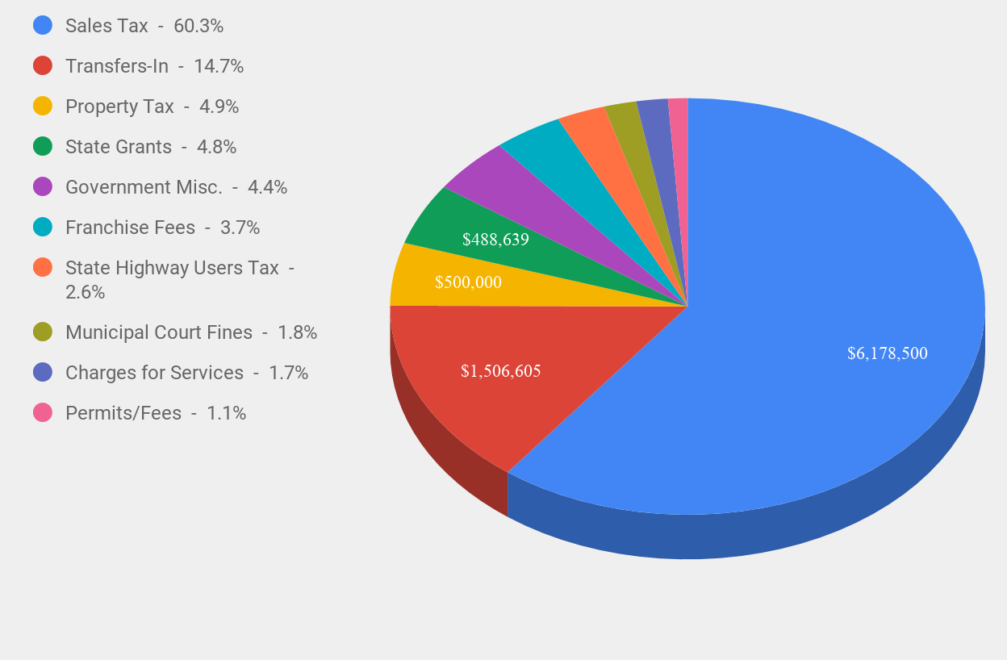
2019 General Fund Revenue
$1,506,605 (14.9%)
$488,639 (4.8%)
$500,000 (4.9%)

Slide 29
School District Bonds
Bonds for the addition passed in 2012 and will sunset in 2024
Bonds for High School passed in 2009 and will sunset in 2030

